Slide 1

It’s Me Parrot Rakhy

Slide 2
basic sys Python + DBMS machine learning data science web development video editing ai expert tools network access

Slide 3
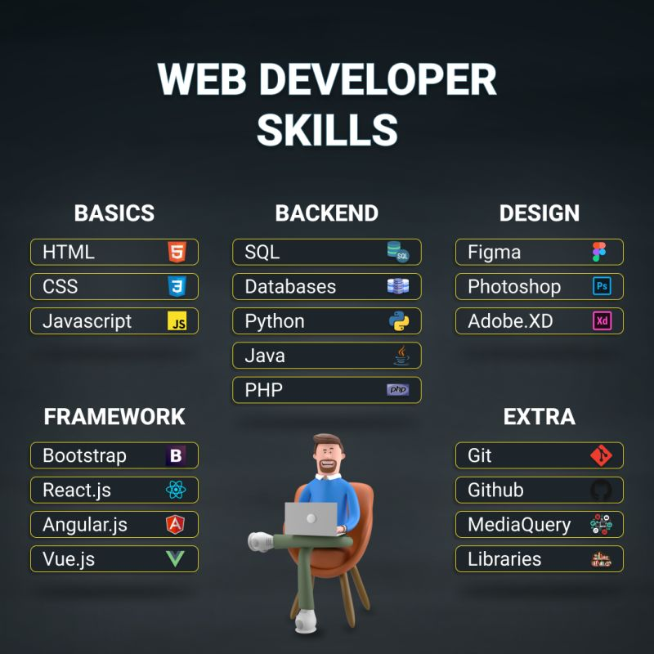

Slide 4
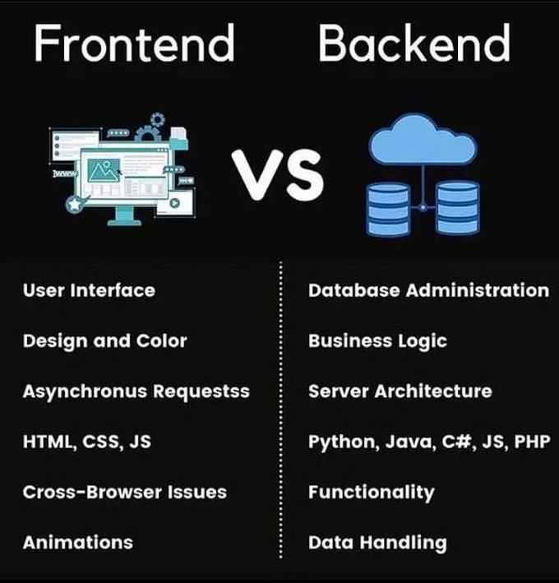

Slide 5
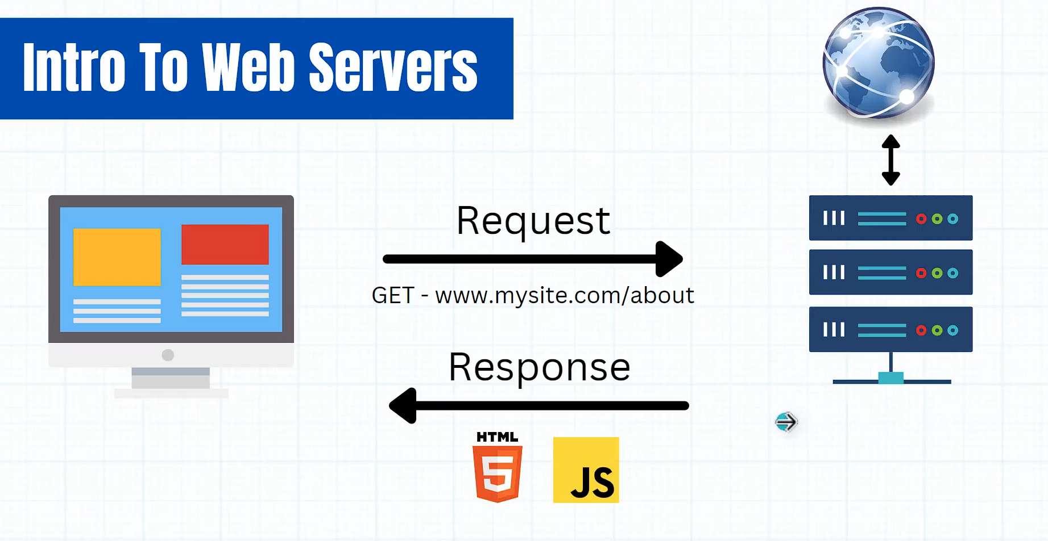

Slide 6
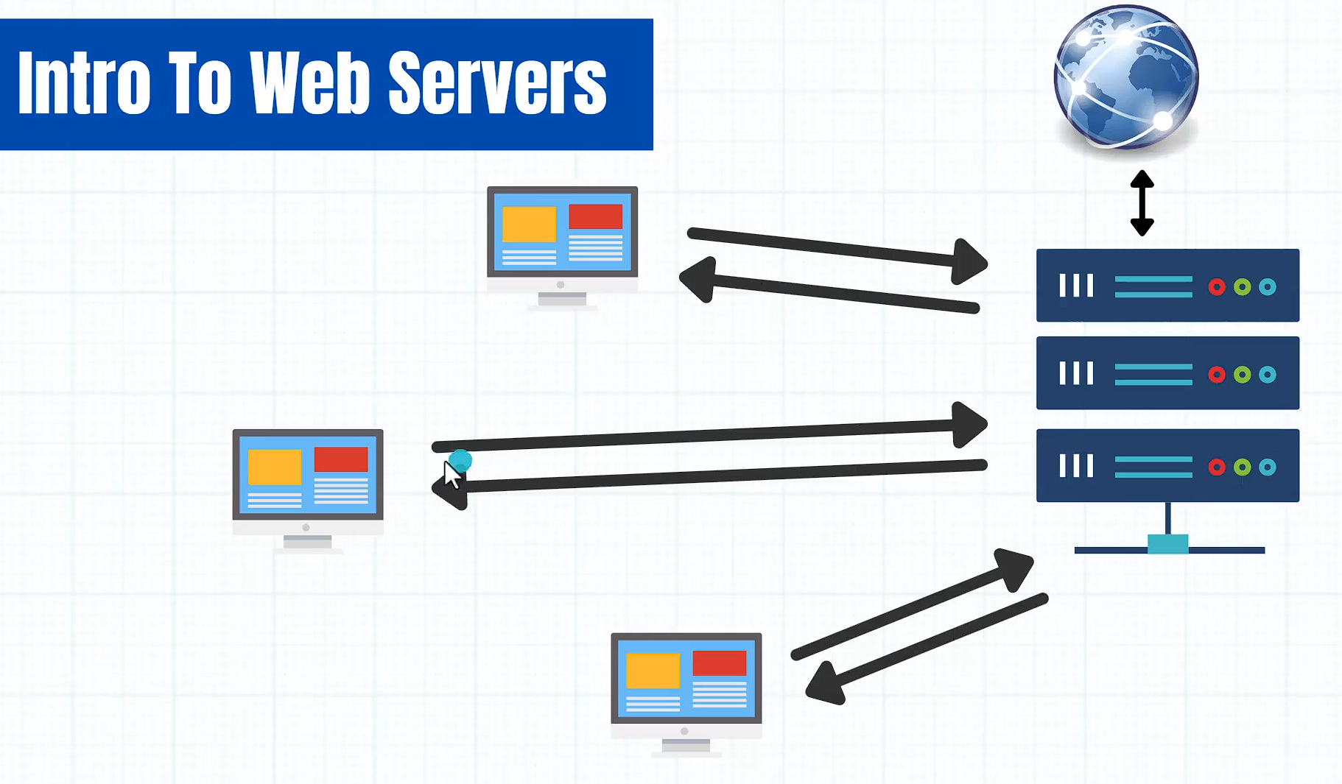

Slide 7
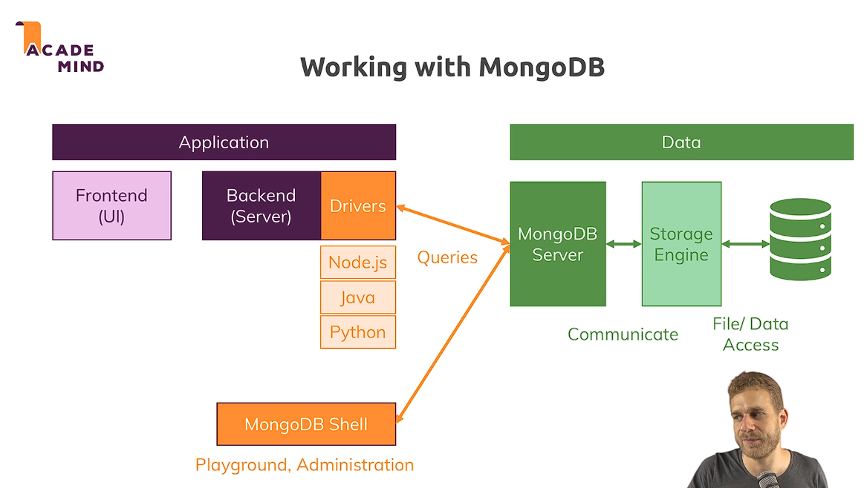

Slide 8
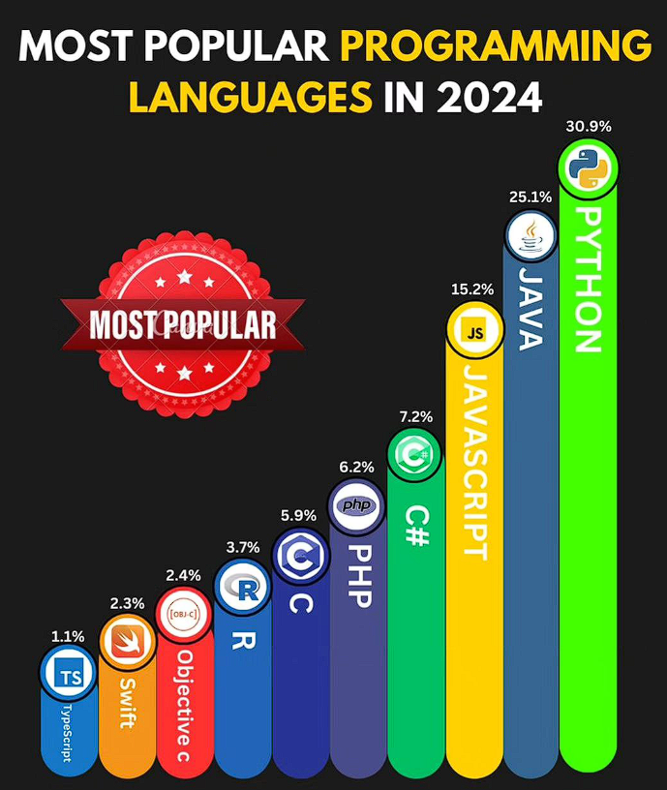

Slide 9
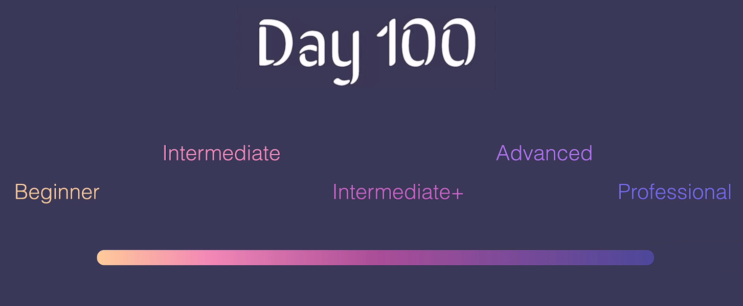

Slide 10
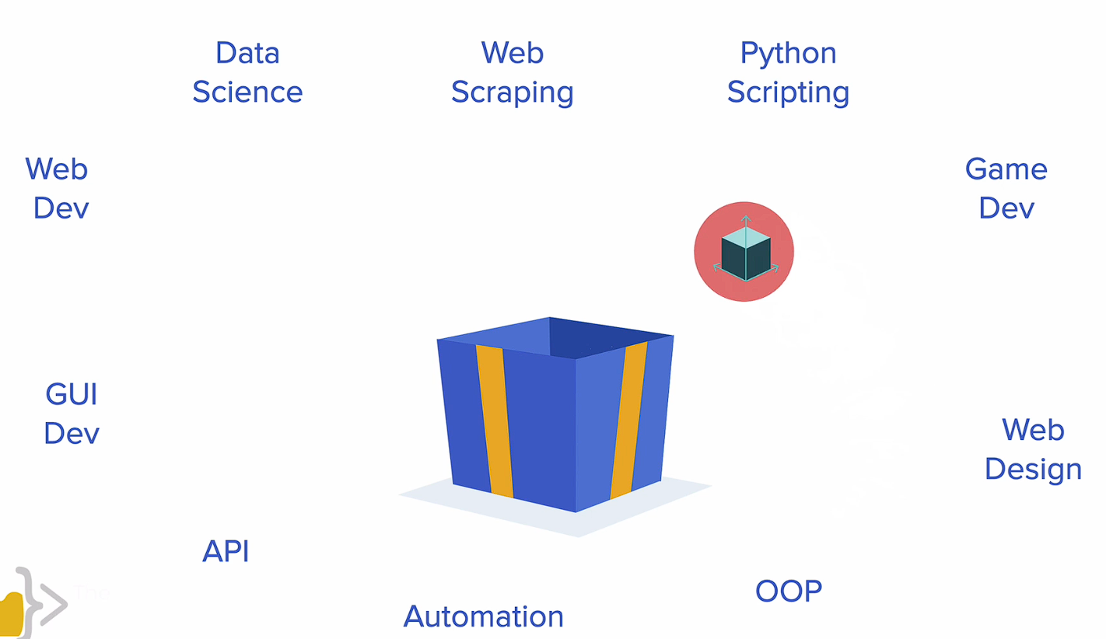

Slide 11
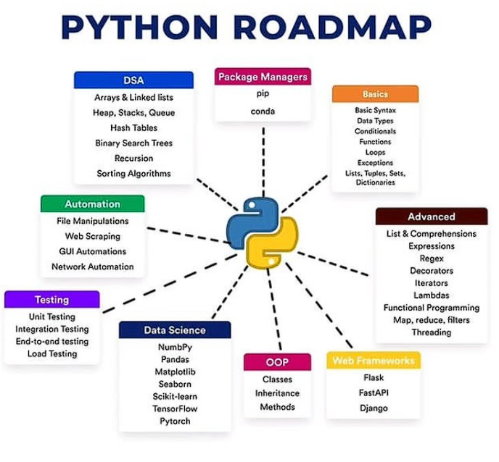

Slide 12
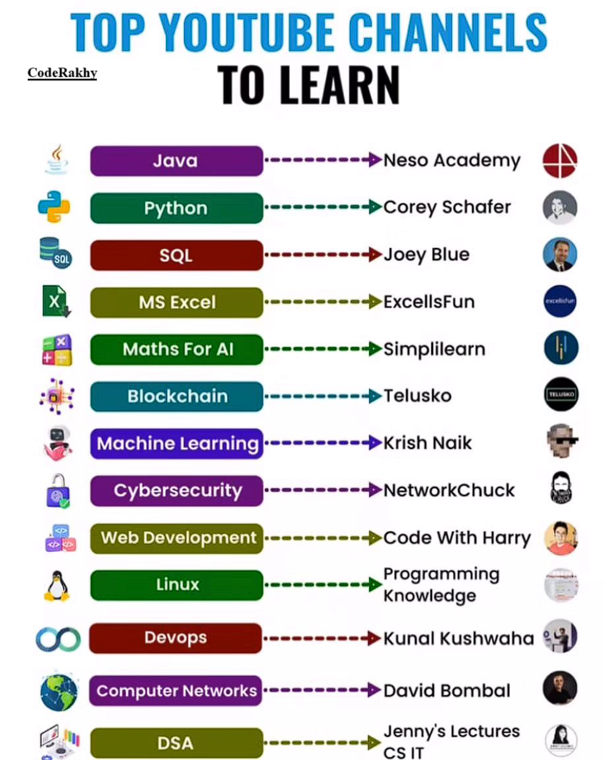

Slide 13
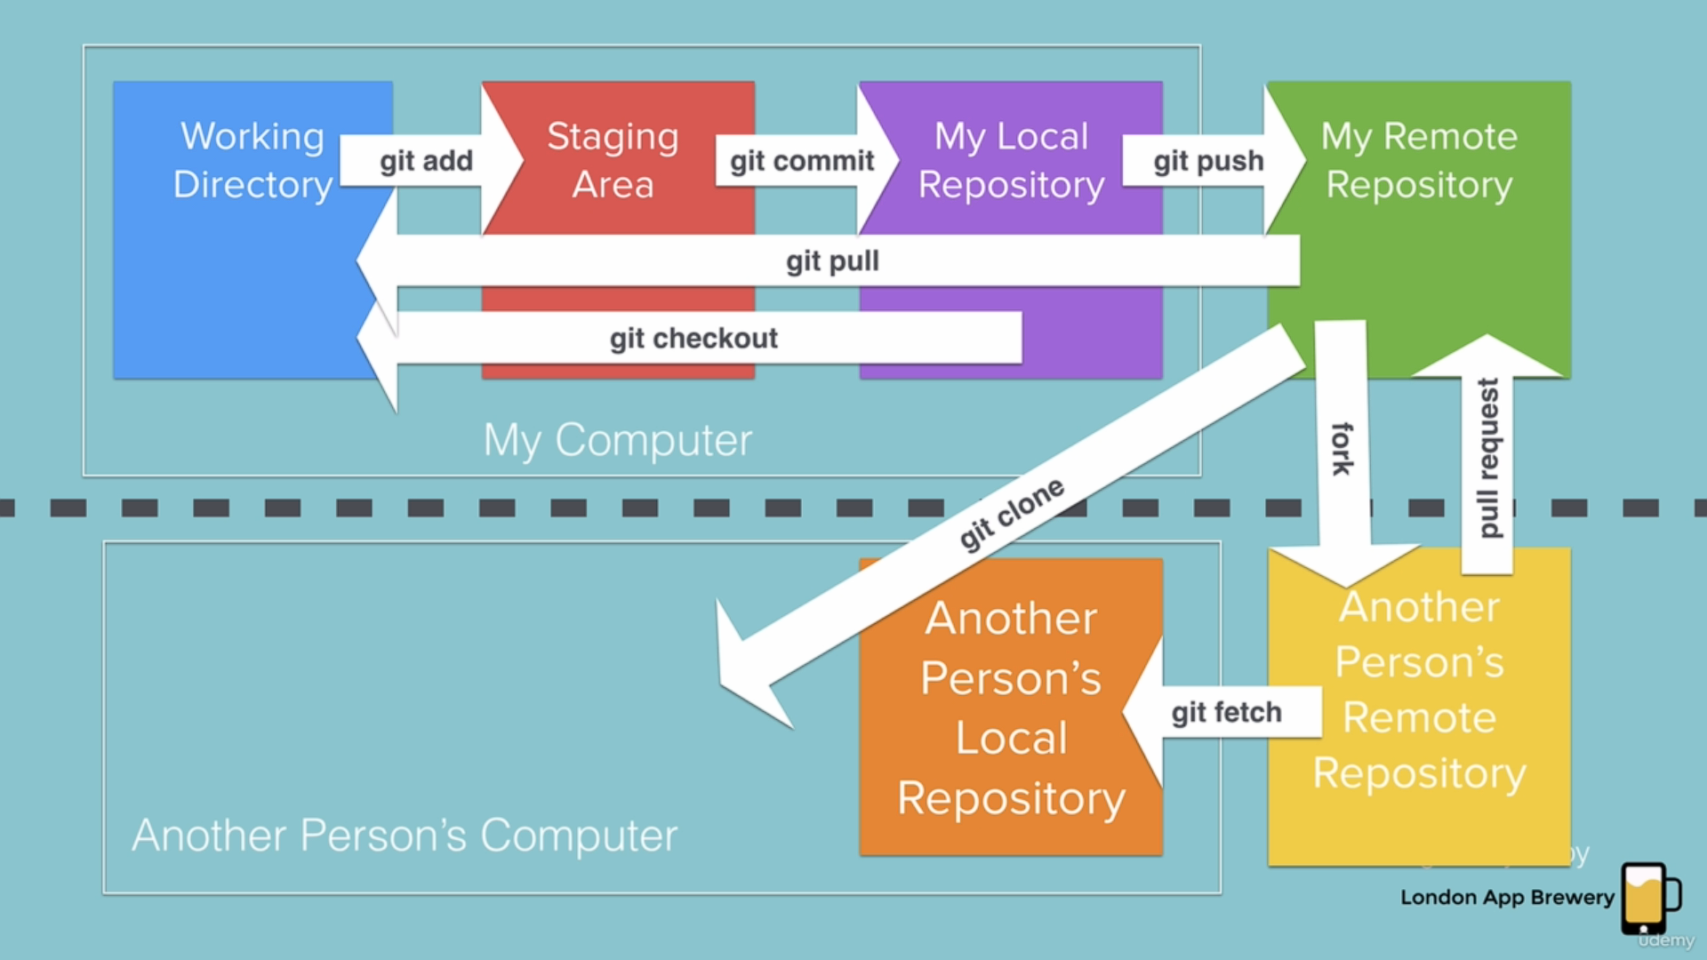
Git Commands

Slide 14
Ai tools

Slide 15
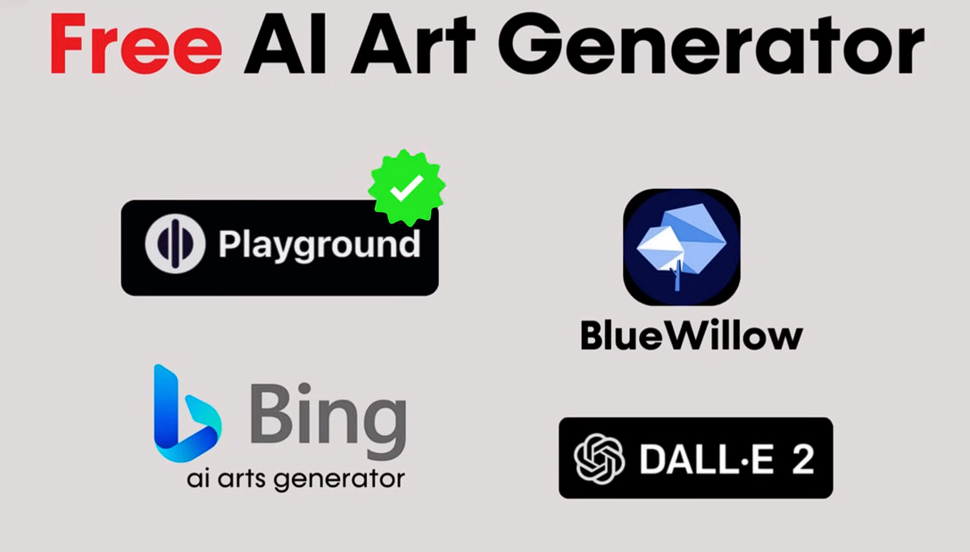

Slide 16


Slide 17
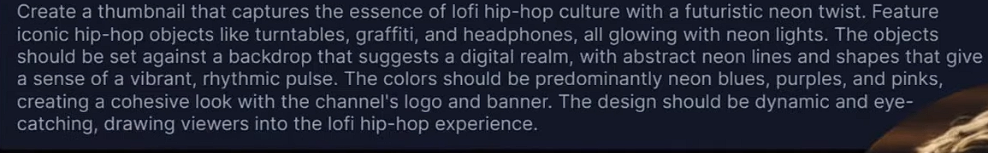
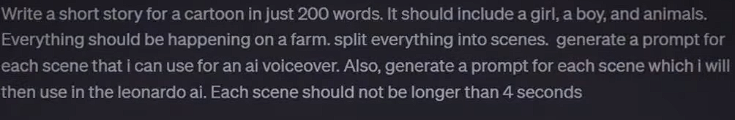
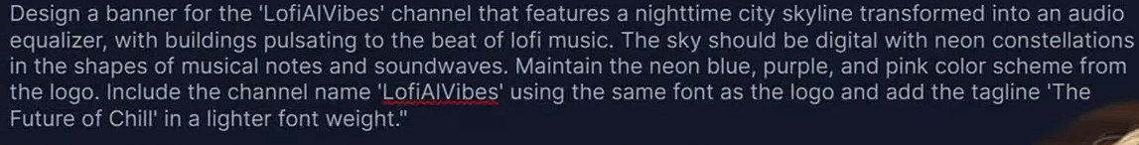
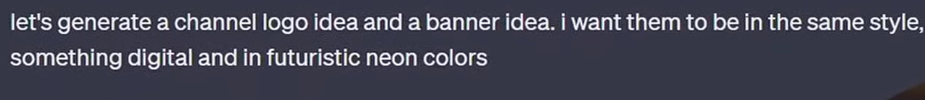
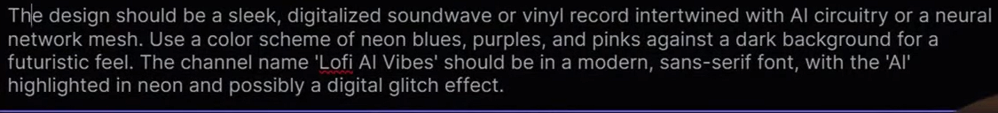
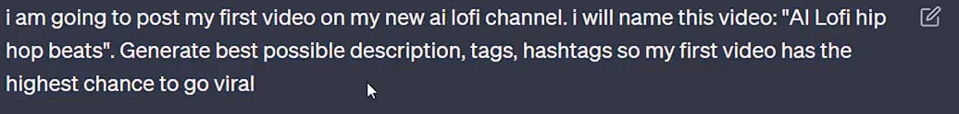

Slide 18
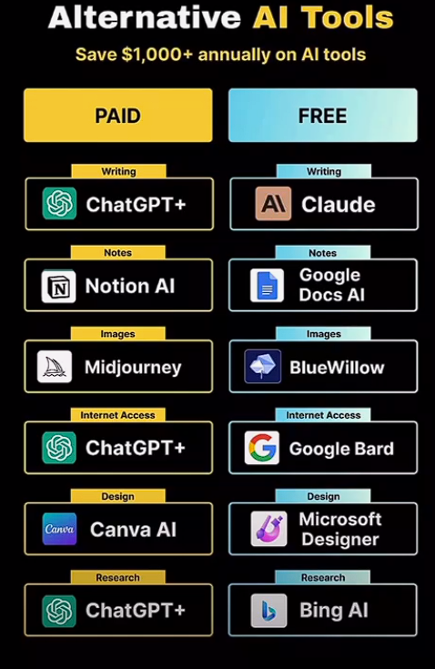

Slide 19
Tips & Tricks
Fake Emails
VPN security
Sharing Screens
Storing Data -- like Clouds
Searching Anyonmsoly – Tor Browser
Latest Updates related to AI and Stock or Financial related info etc. ( YT / Google)
Starting Your Business / YT Channel

Slide 20

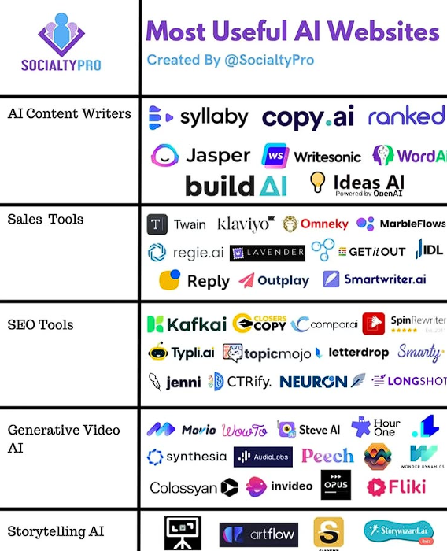
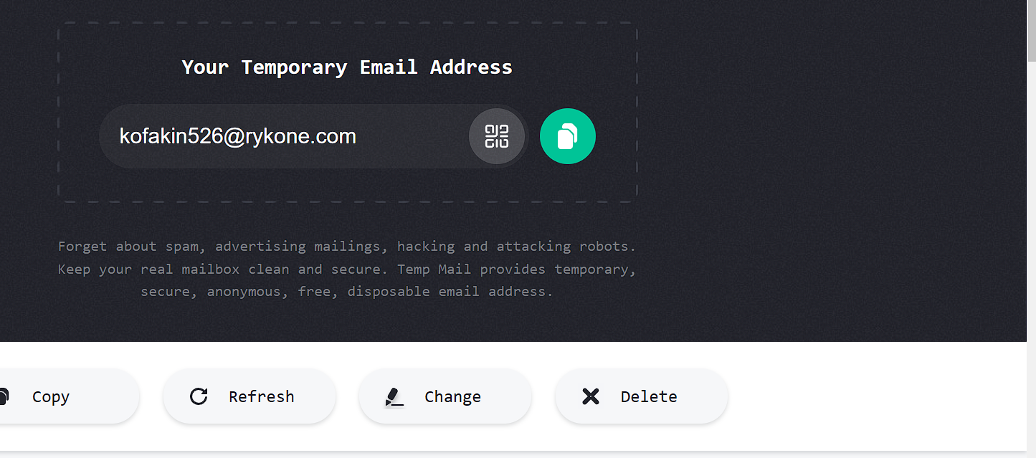





Slide 21
Resource links
If you feel like practicing your Python skills, check out these websites: https://codewars.com/
https://exercism.org/
https://leetcode.com/
https://hackerrank.com/
https://py.checkio.org/
https://www.codingame.com/

Slide 22
END

Slide 23
AI Tools
Day 1 – chatgpt ( ask anything you want)
Day 2 – suno.ai ( for music)
Day 3 -- lenoardo.ai ( for Image generating)
Day 4 – gamma.app ( for ppt presentations using AI)

Slide 24
Network & privacy tricks
Temporay Emails --- https://temp-mail.org/en/
Check your email is secure ---- https://haveibeenpwned.com/
typing test ---- https://keybr.com

Slide 25
Beginner’s level successfully Completed

Slide 26
Intermediate level Starts from here

Slide 27
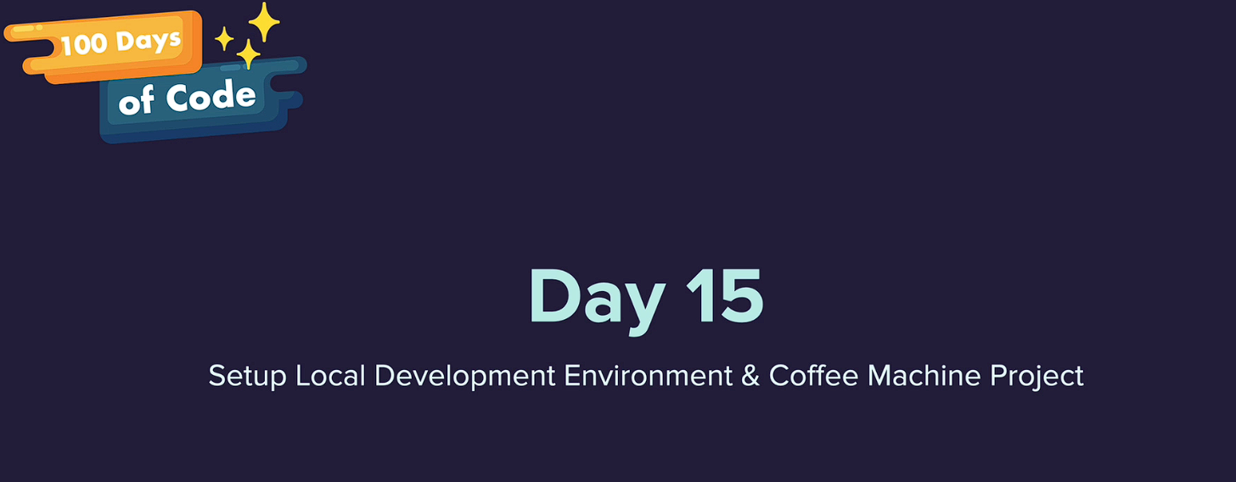

Slide 29
Web development Starts from here

Slide 30
Bootstrap

Slide 31
Web development + intermediate level Starts from here

Slide 32
Advanced level Starts from here

Slide 33
Final level Projects Starts from here

Slide 34
SQL

Slide 35
Site for practice: https://www.sql-practice.com/
Solution Video Link
https://www.youtube.com/watch?v=nYmoQ4r0DVw&ab_channel=BuildwithAkshit

